Slide 1

Global Learning using Solar Projects in China
Andrew Bell
Ivy Tech Community College – Northeast
Notes:
Late last year I was in Wuxi China as part of a faculty exchange program between Ivy Tech Community College and
Wuxi Professional College of Science and Technology. The purpose of my trip was to learning more about how other
cultures address and solve engineering problems. There appears to be a correlation between diversity and innovation
that I wanted to explored. In many ways, I believe that technology and engineering solutions must be viewed in a
global context. During my stay we built a single axis 100W solar panel tracker using the skills of a small international
team. I wanted to take the opportunity to share my observations and discuss ideas on how to use solar technology to
inspire global involvement and learning.

Slide 2

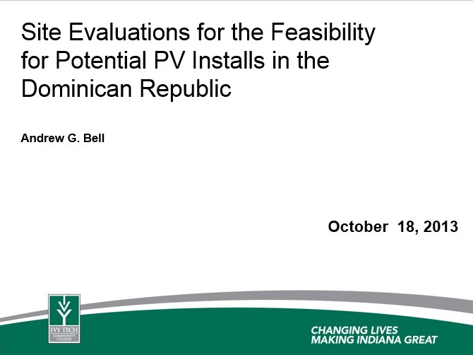
Introduction
Participated in 1st cohort for GLAI (2013-2014)
Participated in Renewable Energy trip to Costa Rica (2013)
Completed training in PV installs (2013)
Traveled to Dominican Republic for evaluation of candidate solar panel site s (2013)
Traveled to Wuxi China as part of Faculty Exchange (2014)

Slide 3
Conclusion
We need more global content in our courses
Renewable energy is an important technical issue facing the world
Solar technology is an important part of renewable energy
Dominican Republic has severe electrical problems
China could be a partner to develop global solution to solar technology

Slide 4
The Plan & Goals
Use solar technology to introduce students to “challenges facing global society”
Introduce students to global concepts in ENGT 120 (an intro to engineering course)
learning goals & objectives
1.) Learn that we are not alone on this planet.
2.) Engineering technology can be used to help improve the quality of life of other people.
3.) Other cultures can provide new insight into solving engineering problems through diversity.
Globally we need renewable energy to reduce greenhouse gas emissions

Slide 5
The Project
Converts sunlight to electrical energy
Design, build and test a 100W Single Axis Solar Panel System
Controls charging of battery
Solar Panel
Battery Charger
Inverter
Converts DC to AC voltage
Battery
DC power source (stores energy)
Tilt
Control
Controls the tilt angle of the solar panel

Slide 6
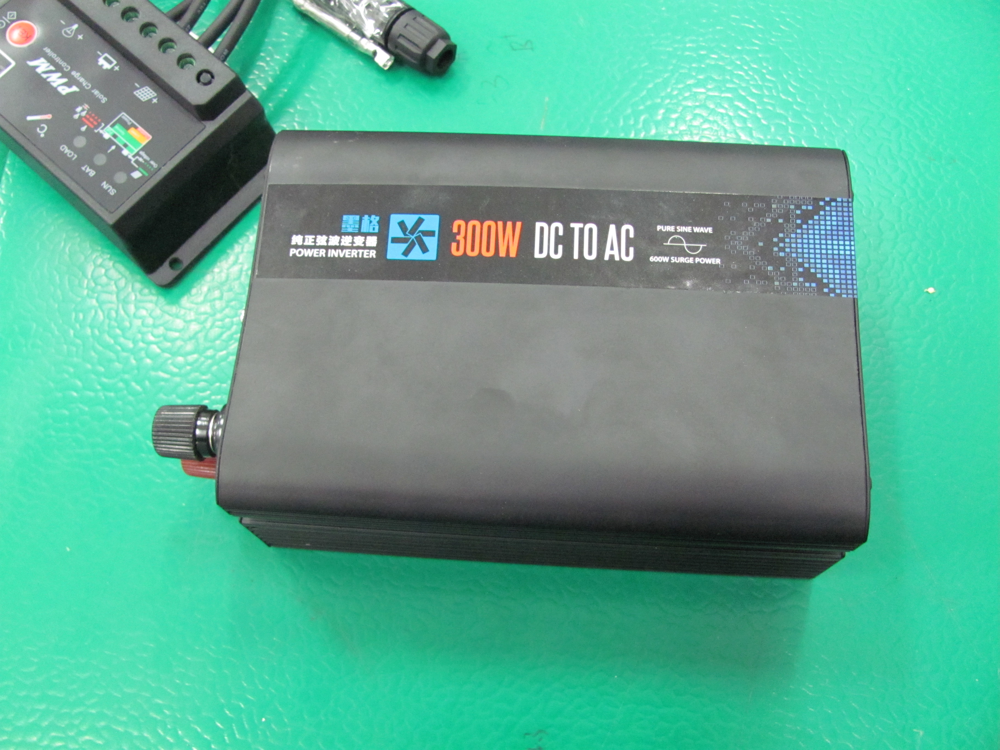
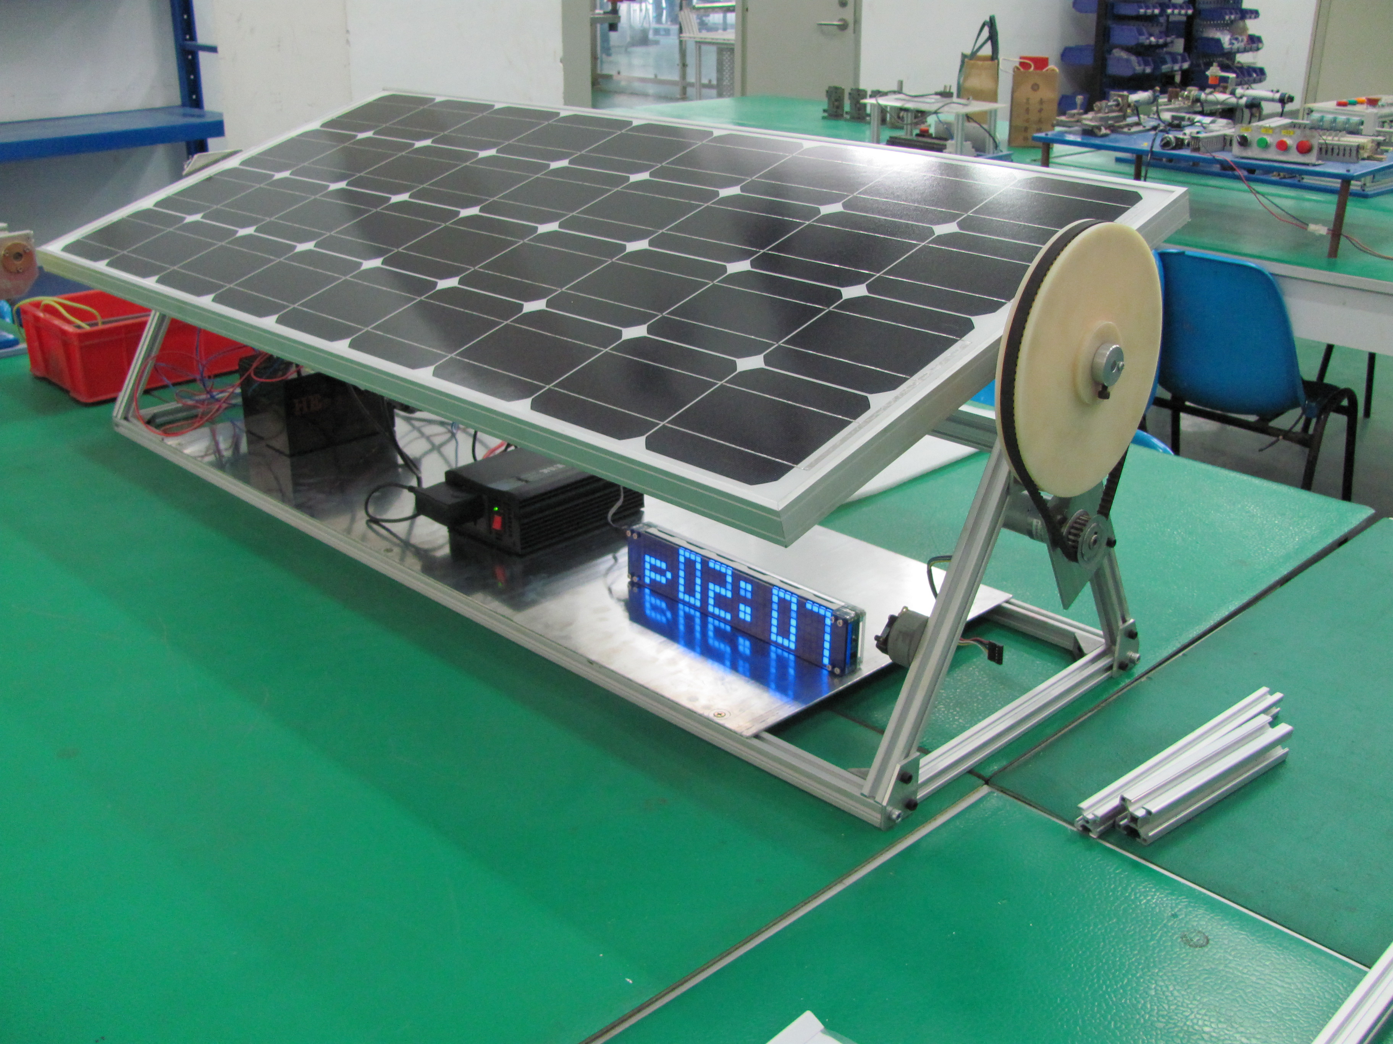
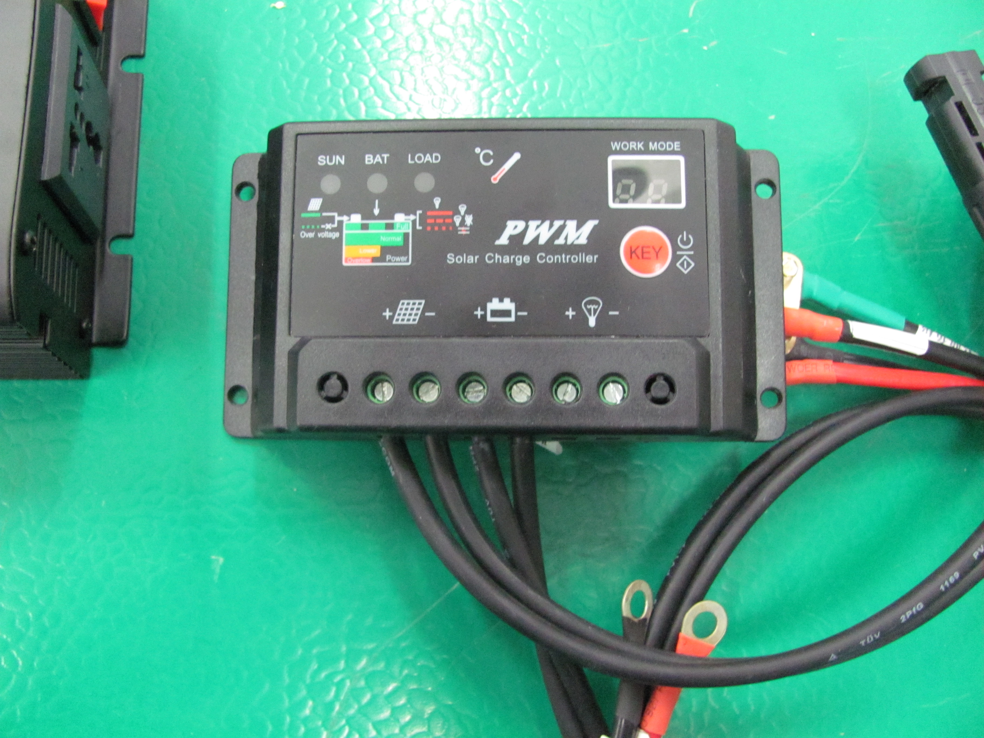
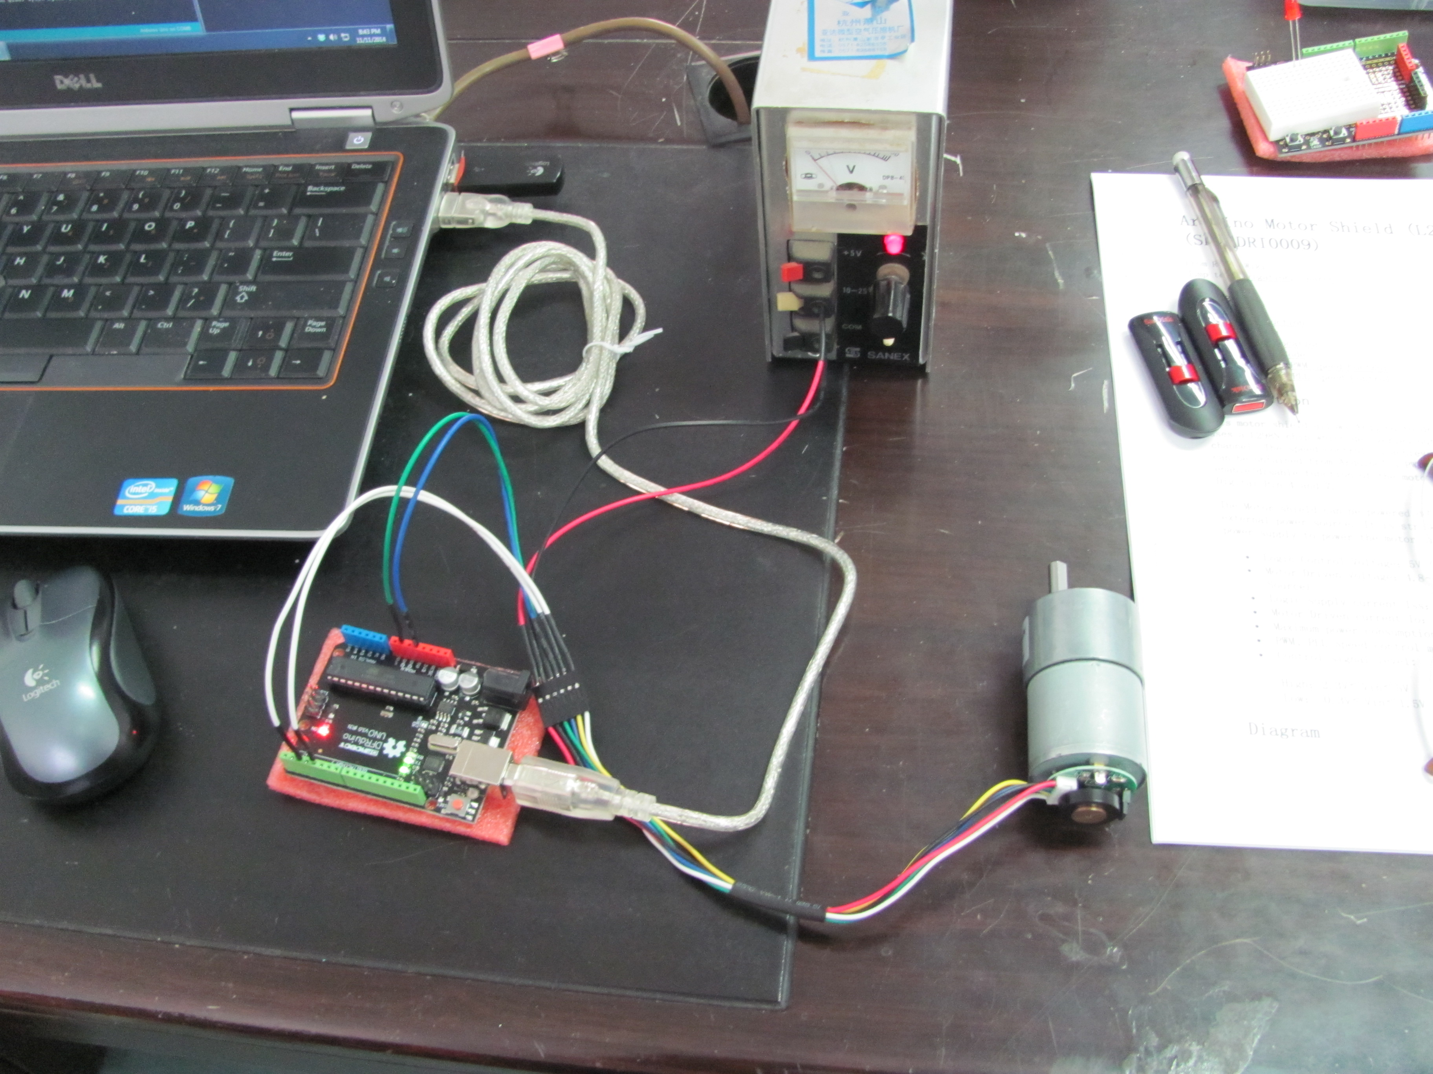
The Project
Design, build and test a 100W Single Axis Solar Panel System

Slide 7
The Purpose
Create added teaching resources for Wuxi Professional College of Science and Technology
Investigate effectiveness of global teamwork for Ivy Tech Community College
Develop global partners in education
Explore potential for cross program thematic learning
Build a renewable energy platform that can be used to teach global teamwork

Slide 8
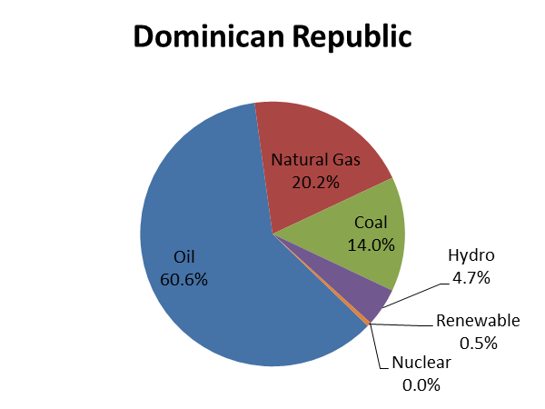
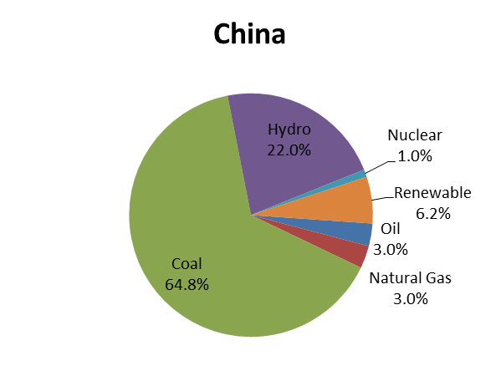
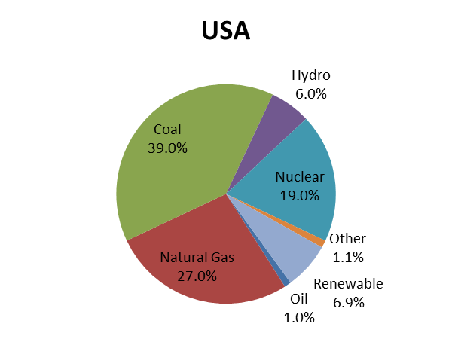
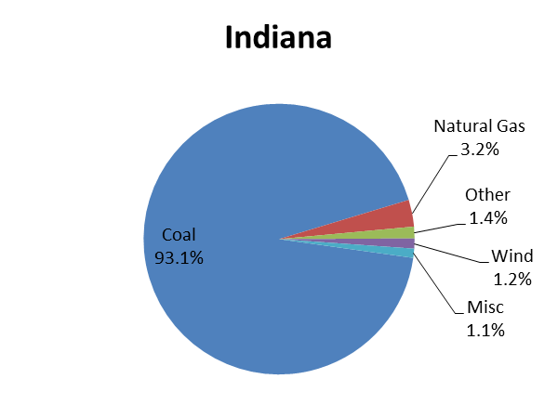
Cultural Differences (compared to US)
Dominican Republic uses 89.61% less electricity & makes 81.63% less money
China uses 67.79% less electricity & makes 81.44% less money
Electricity Generation by Energy Source
Notes:
http://www.ifitweremyhome.com/compare/US/DO
The per capita consumption of electricity in Dominican Republic is 1,297kWh while in The United States it is 12,484kWh.
The GDP per capita in Dominican Republic is $9,700 while in The United States it is $52,800
http://www.ifitweremyhome.com/compare/US/CN
The per capita consumption of electricity China it is 3,925kWh in while in The United States is 12,185kWh.
The GDP per capita in China is $9,800 while in The United States it is $52,800

Slide 9
The Engineering Design Process
Define requirements
Identify the problem
Research problem
Selection options to pursue
Design & Build Prototype
Brainstorm
solutions
Test & Evaluate Prototype
Share results
Redesign if necessary
Notes:
Define the requirements via capture of the voice of the customer
Verification and validation
Verification = Does the design meet the requirements?
Validation = Does the design meet the expectation of the customer?
Should also look at why?

Slide 10
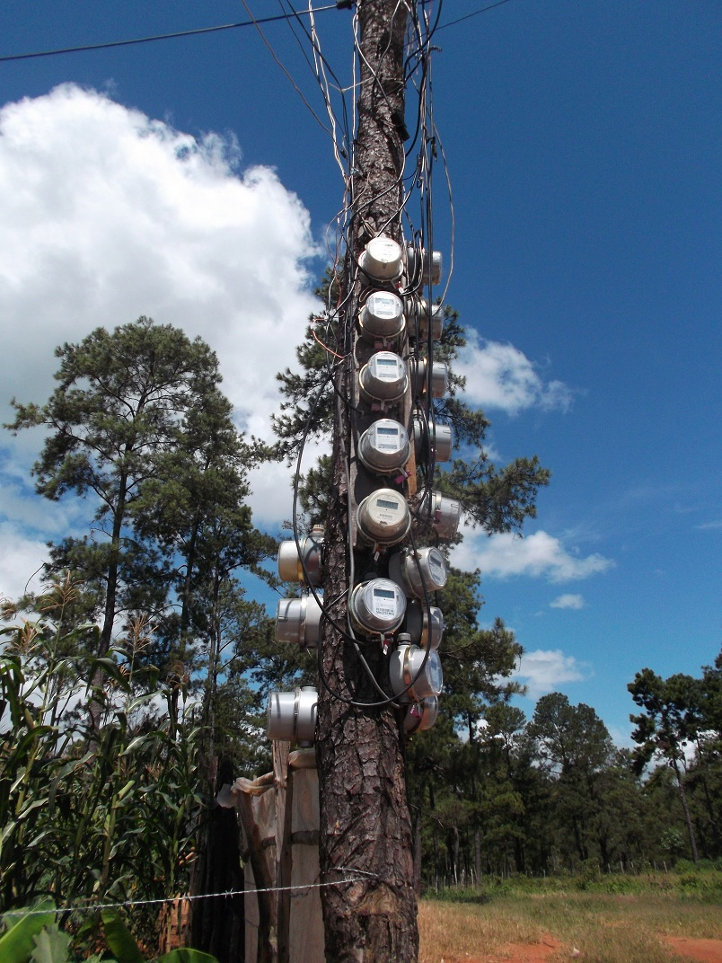
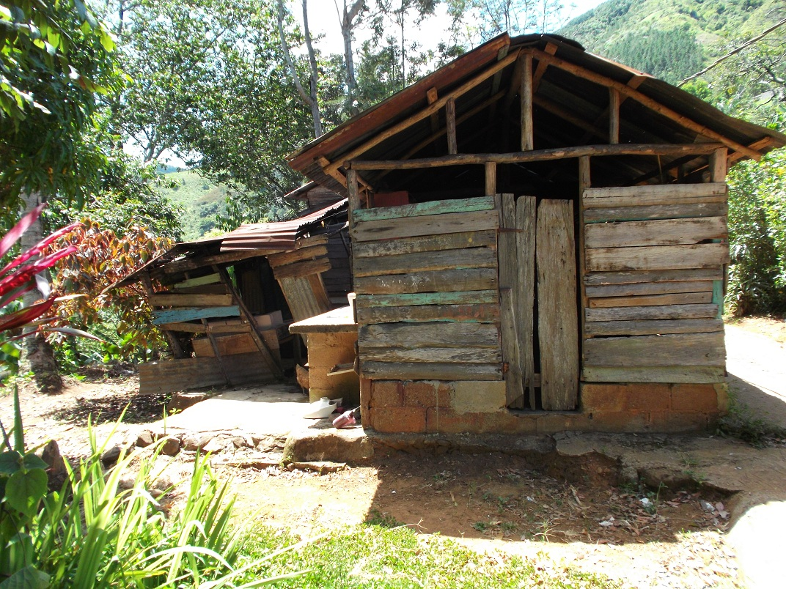
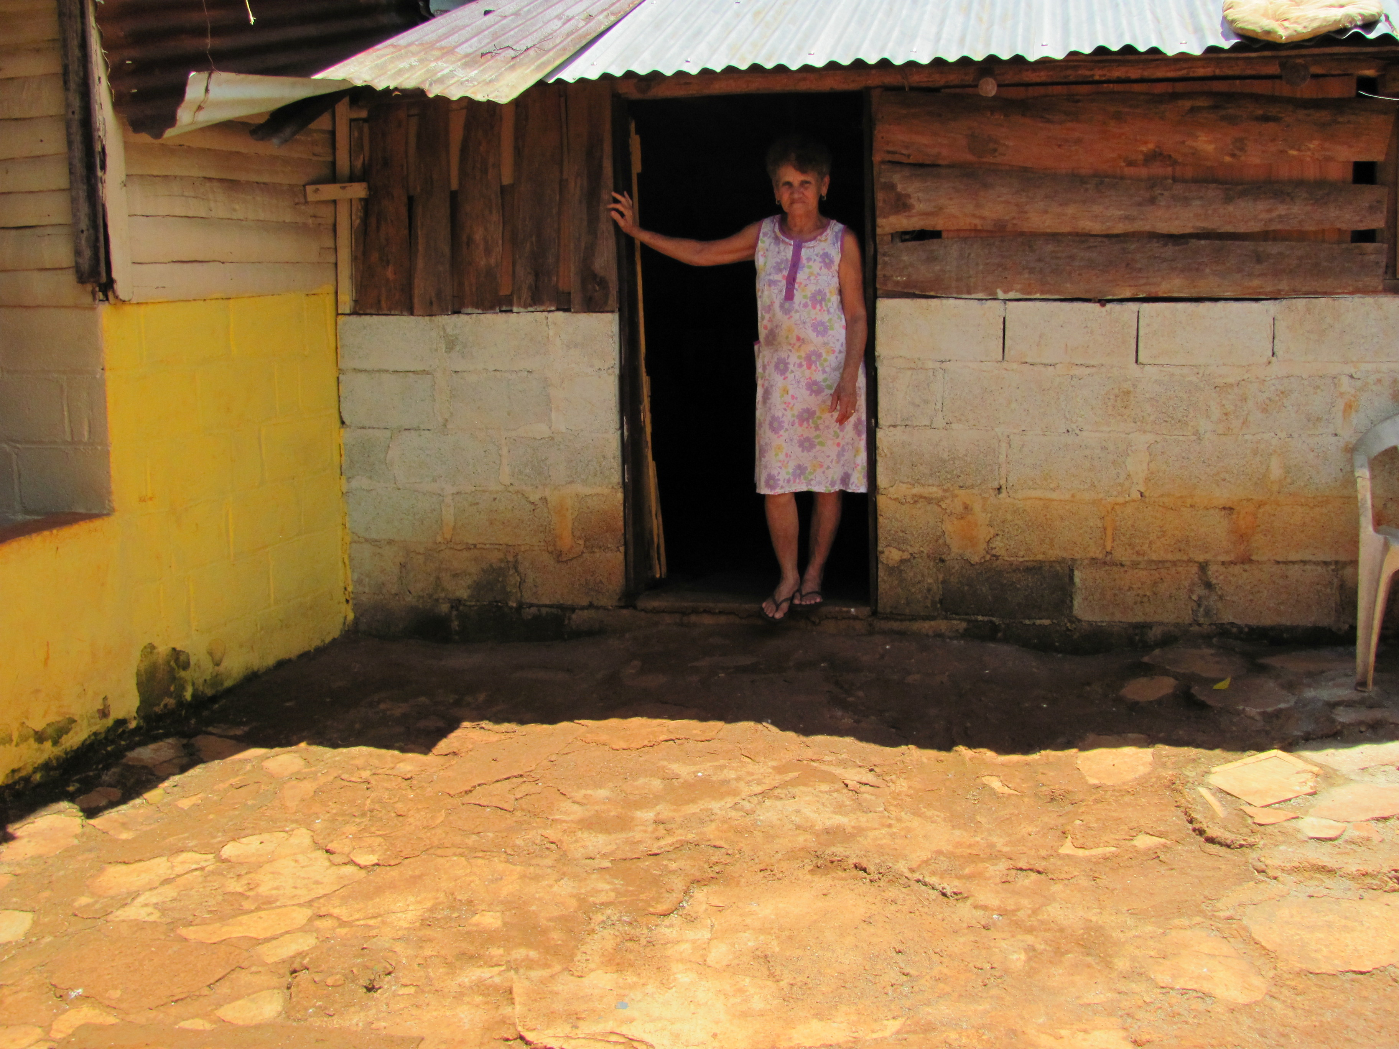
The Problem (DR)
People in the Carebiean and Central America cannot afford electricity because it is so expensive to produce and the cost of living (GDP per person) is so low
The high cost is partly tied to the lack of natural resources which can be used to produce electricity
Fossil fuels use to produce electricity can have a negative impact on the generation of greenhouse gases.

Slide 11
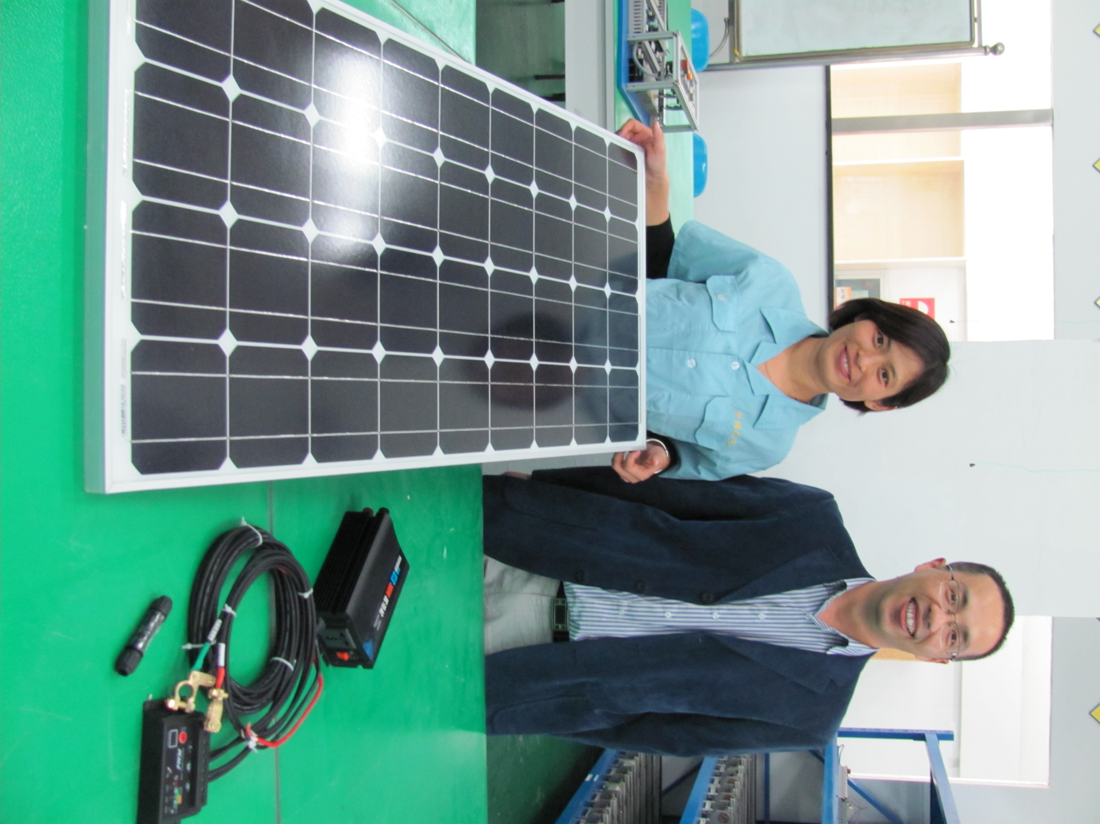
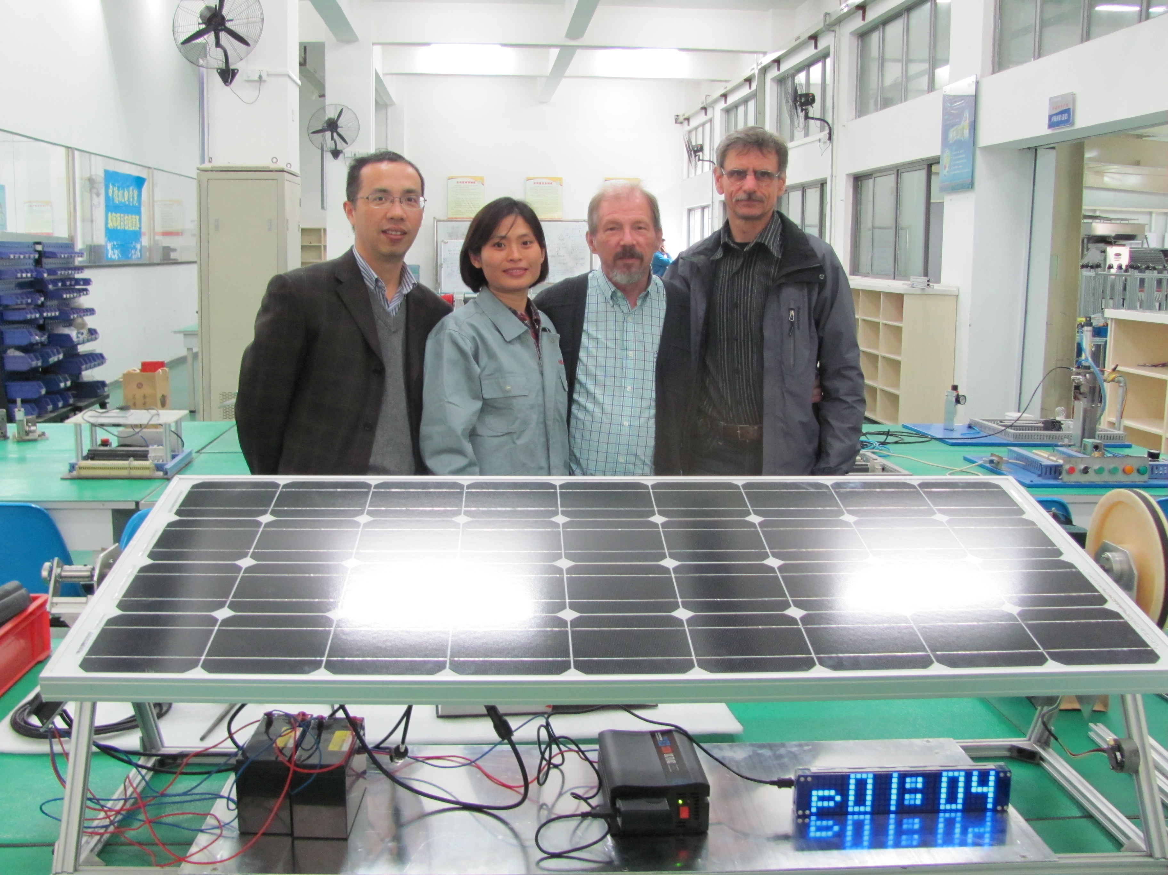
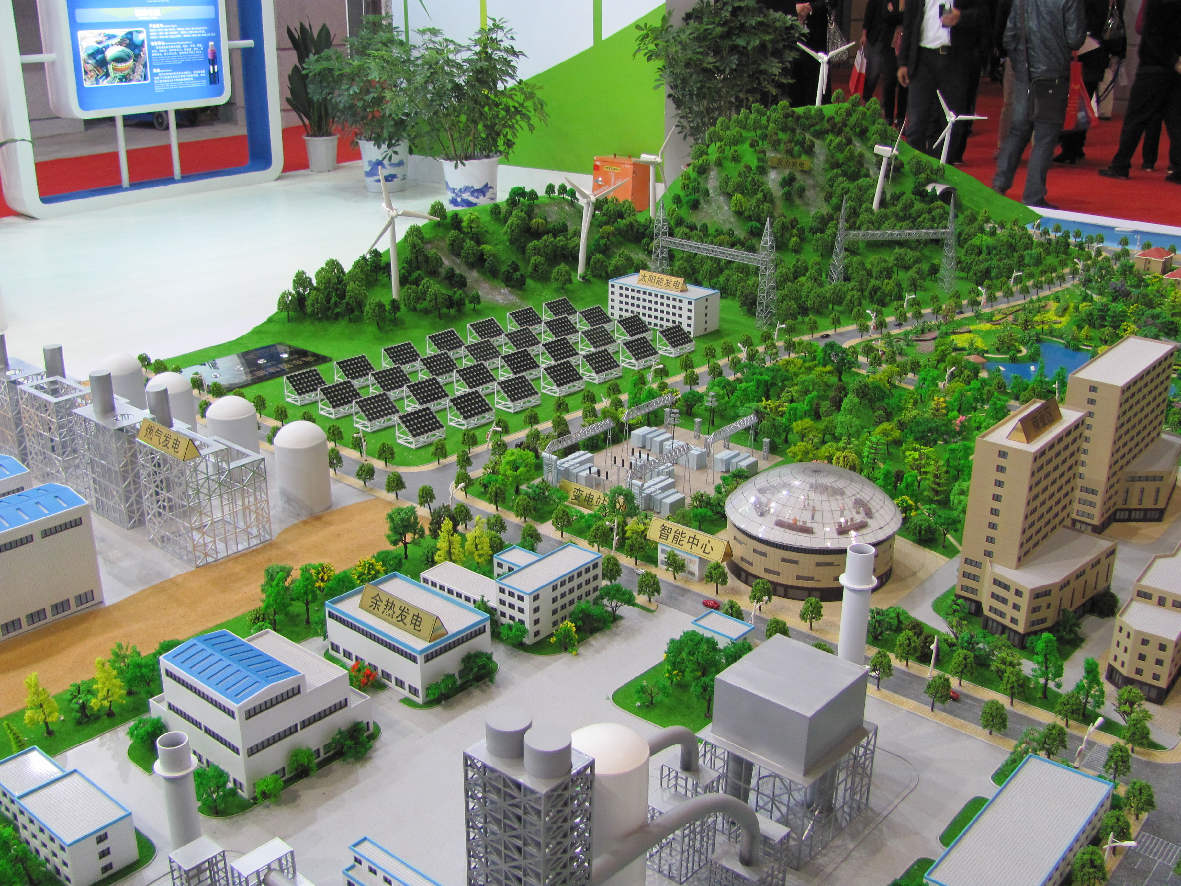
The Solution (China)
Solar energy can be used to generate electricity
China is the primary solar panel manufacture in the world
Cost of 100W Solar Panel System was 550 RMB = $100

Slide 12
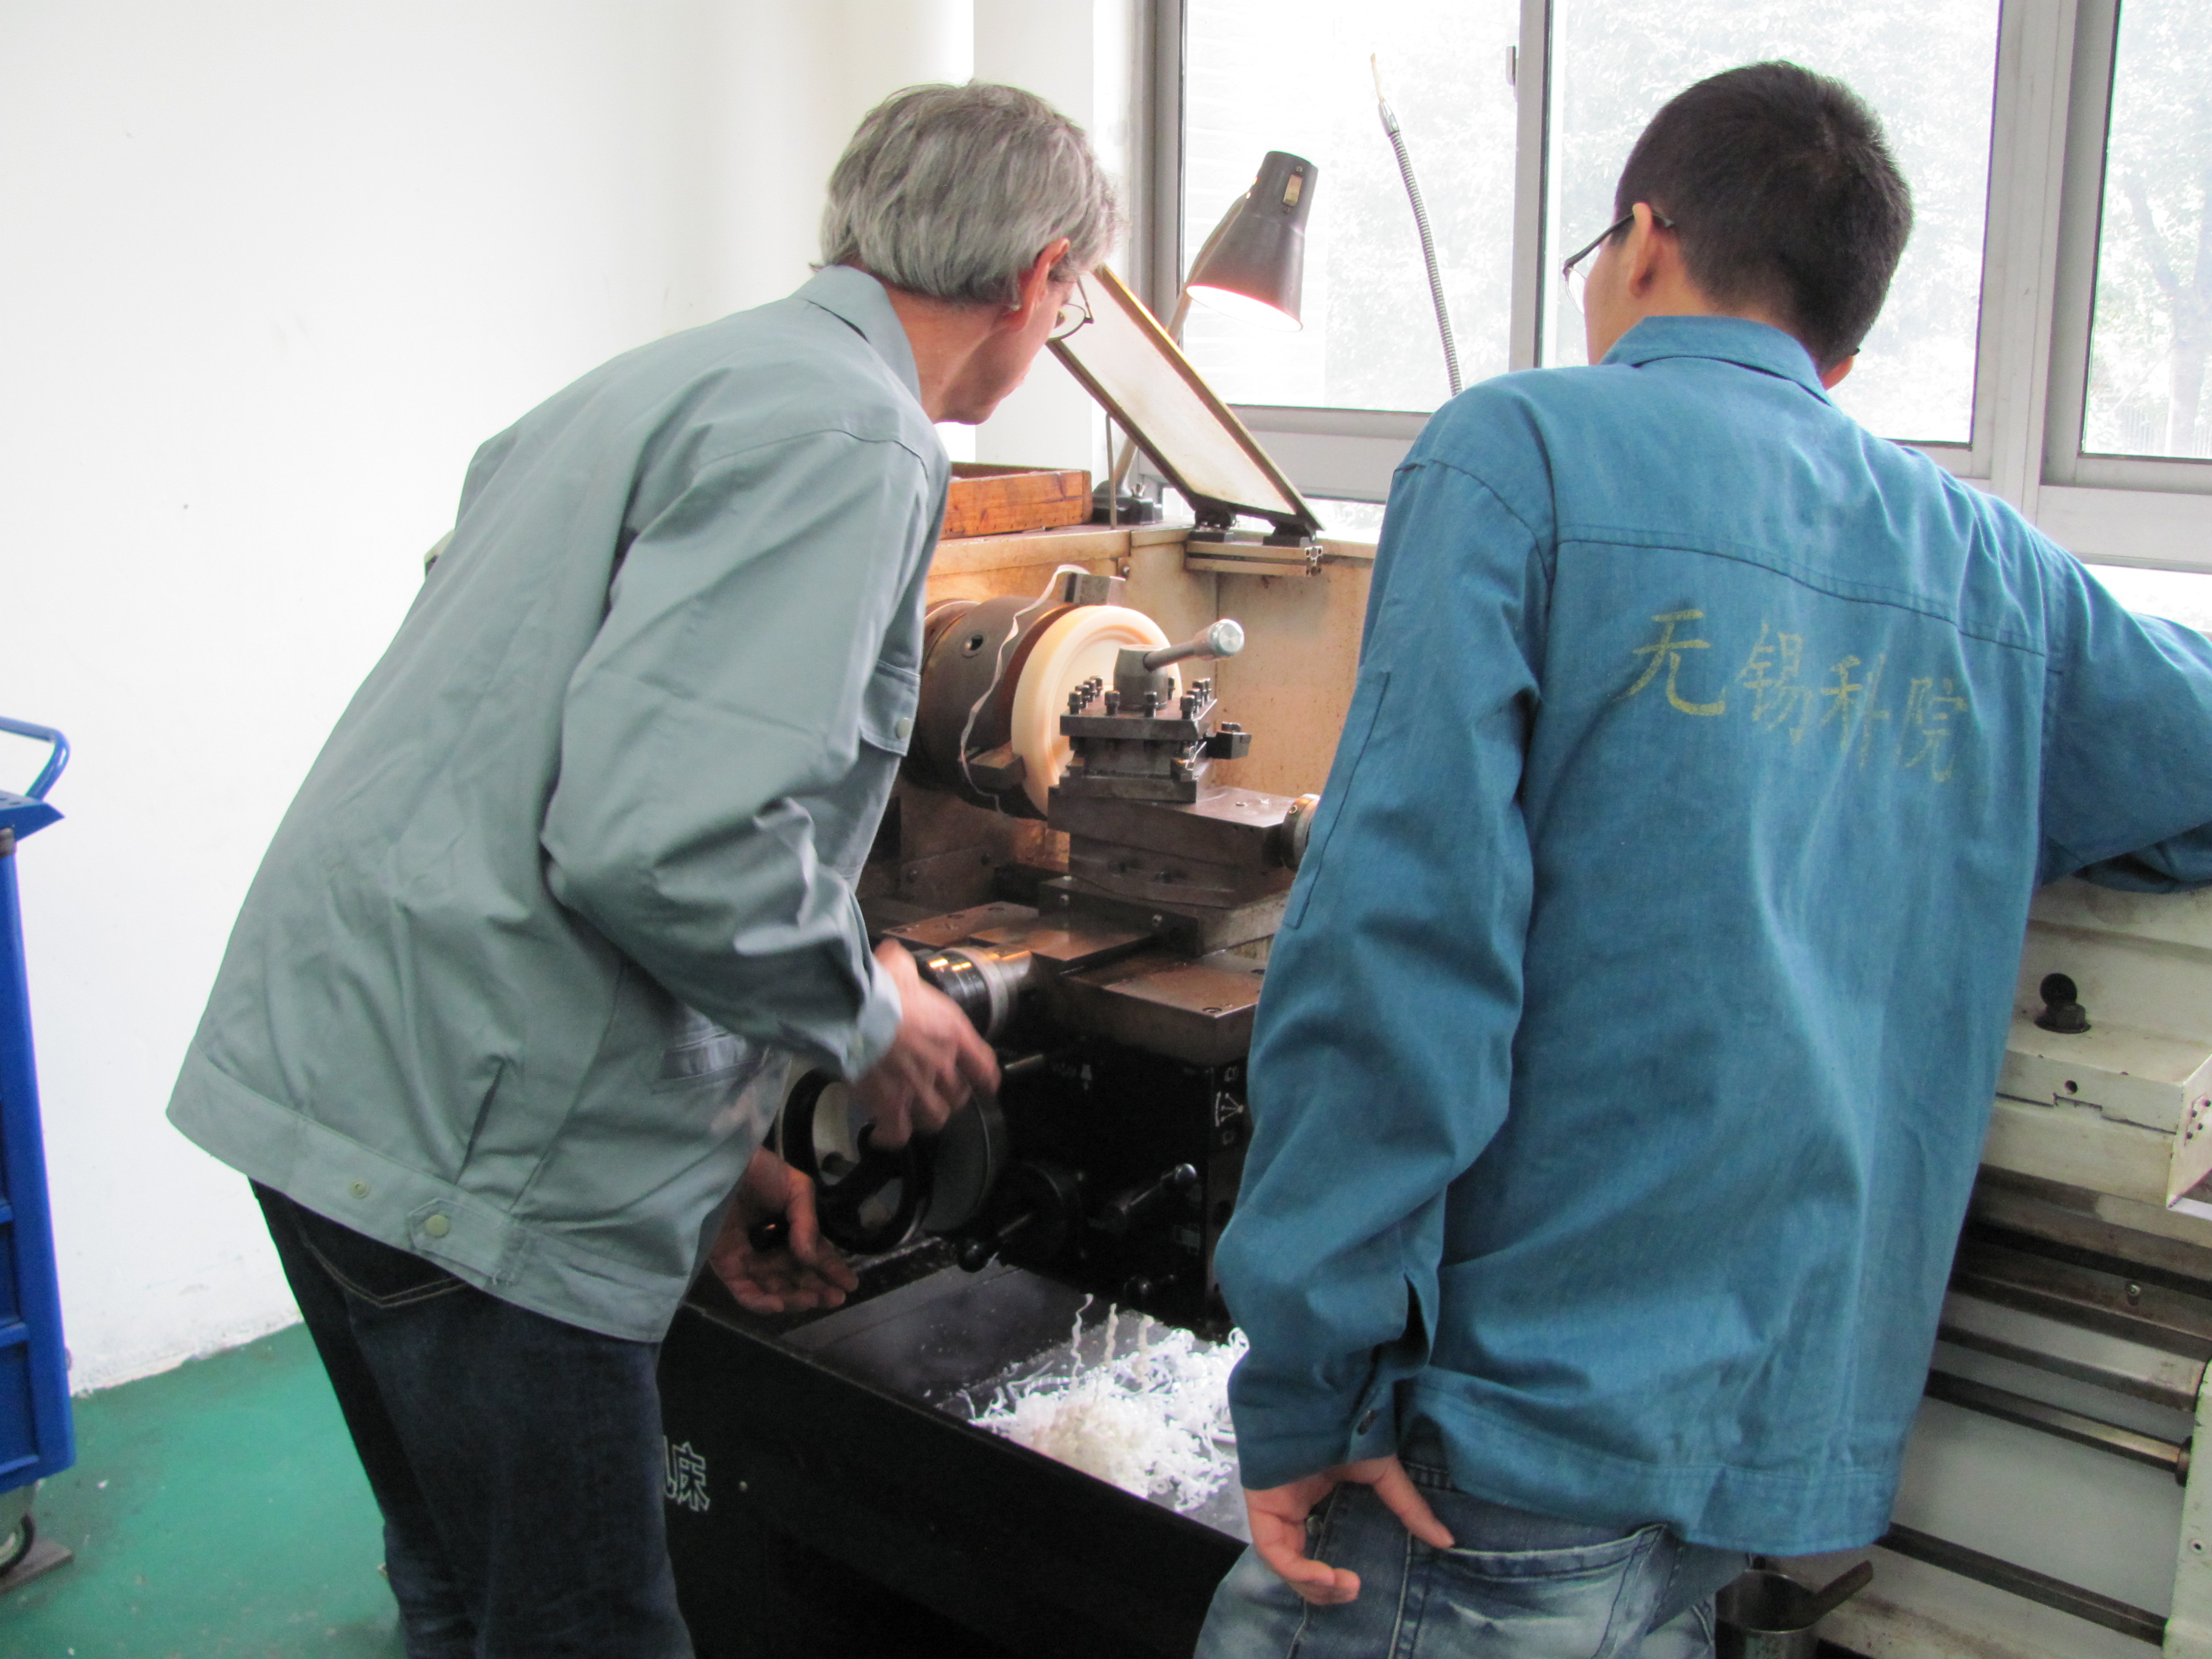
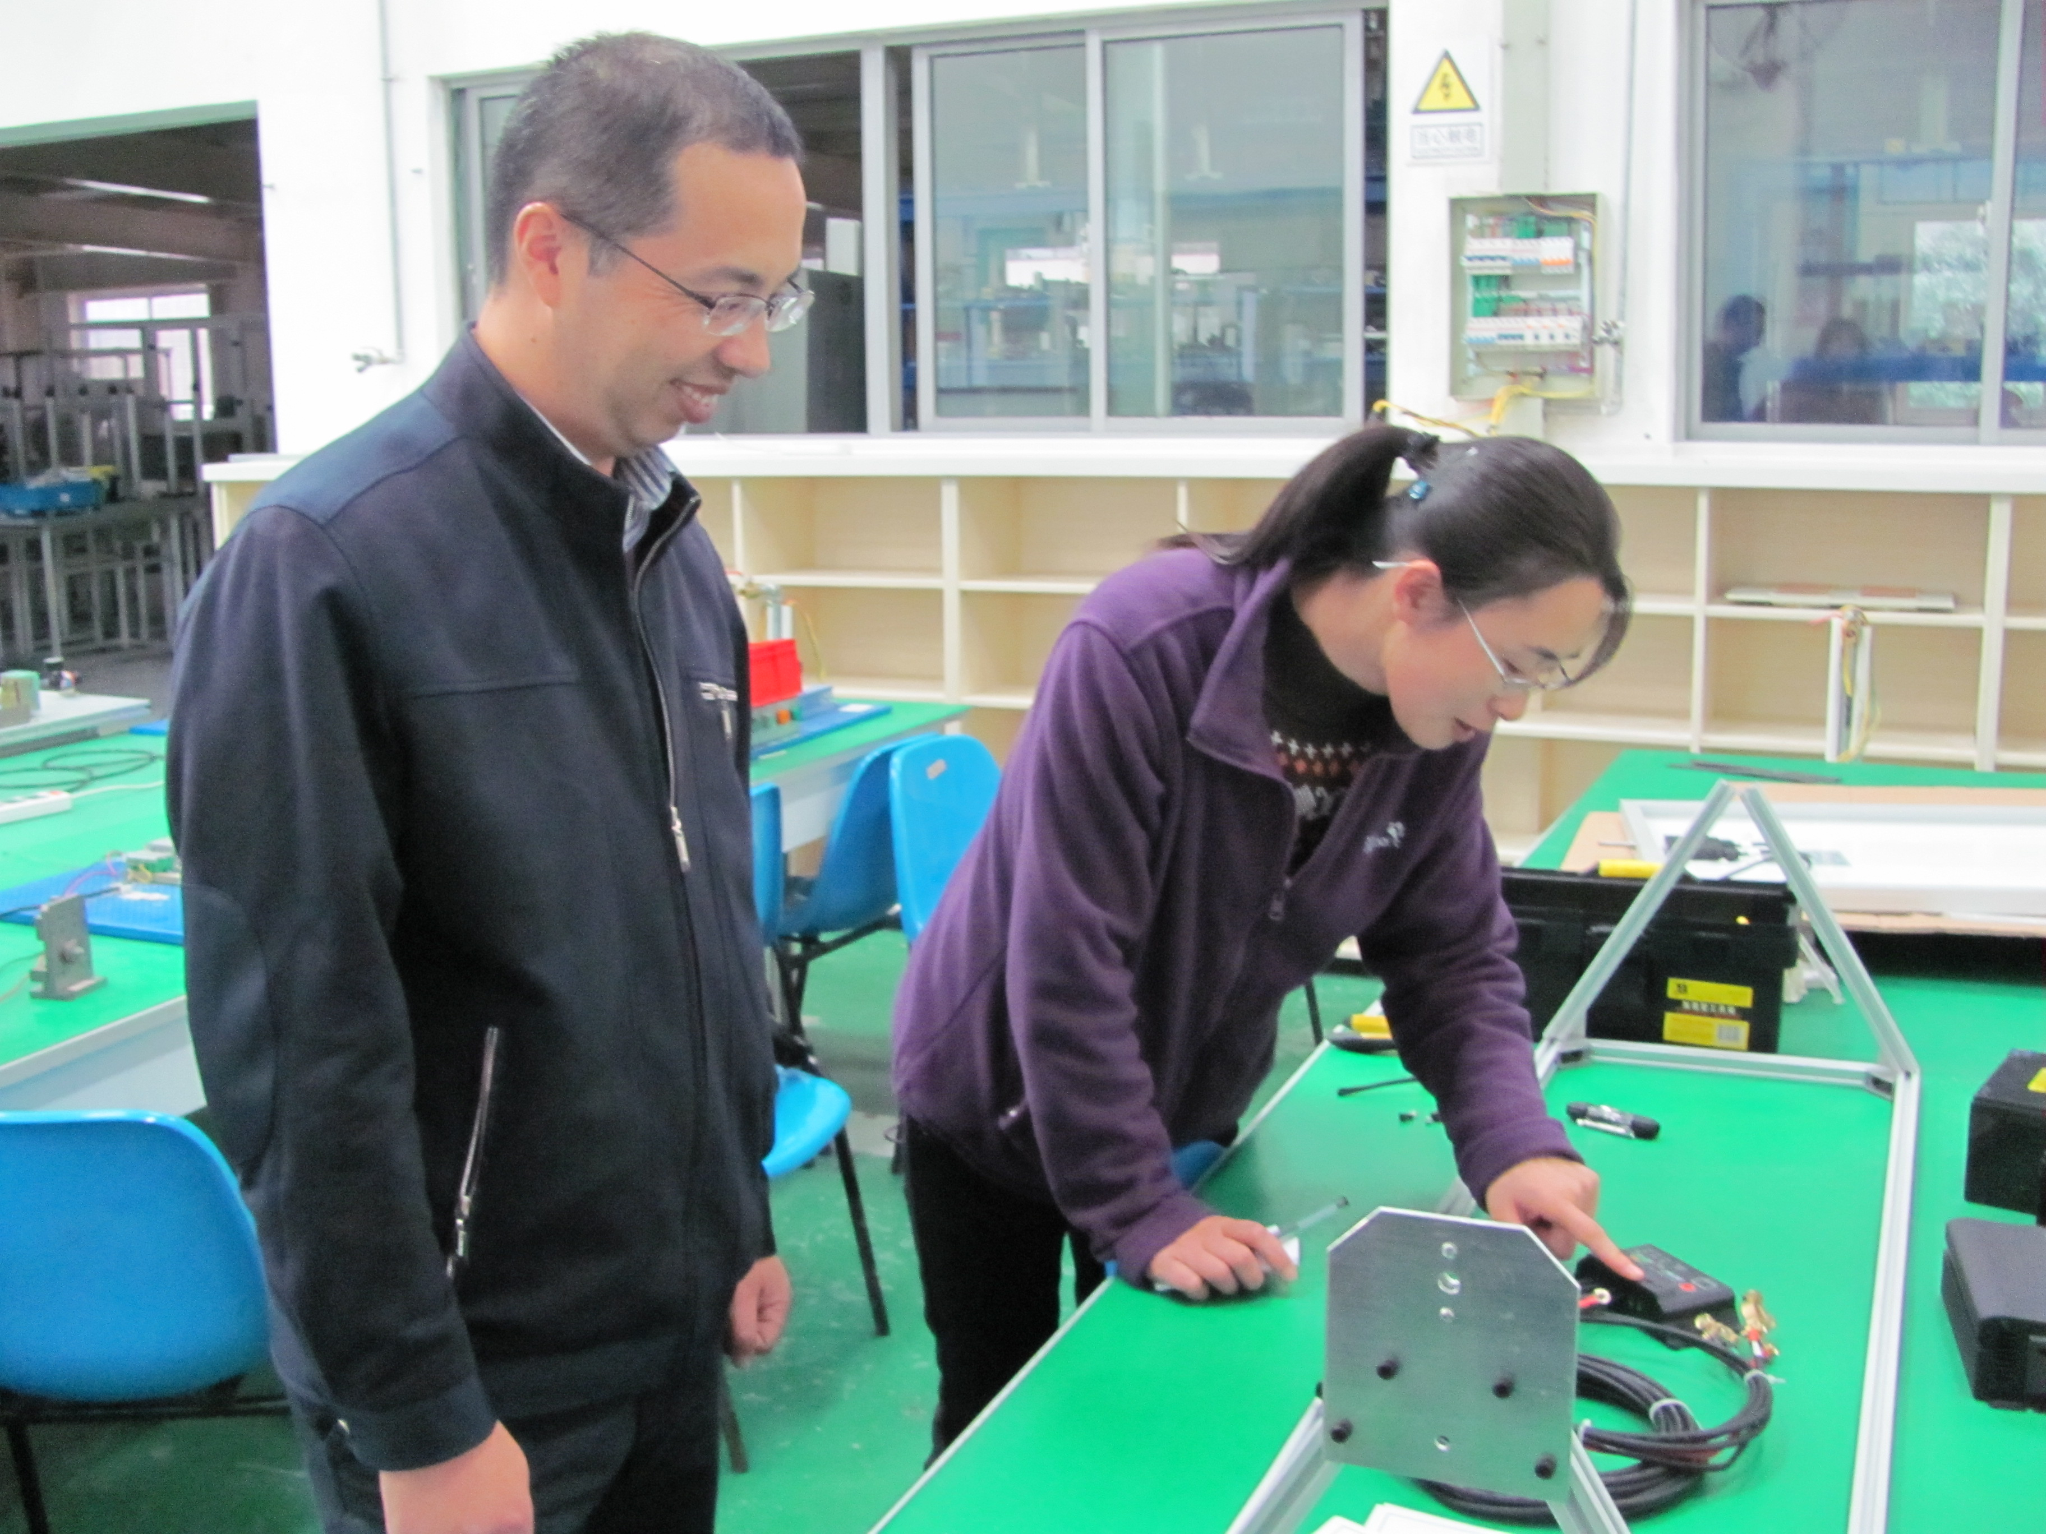
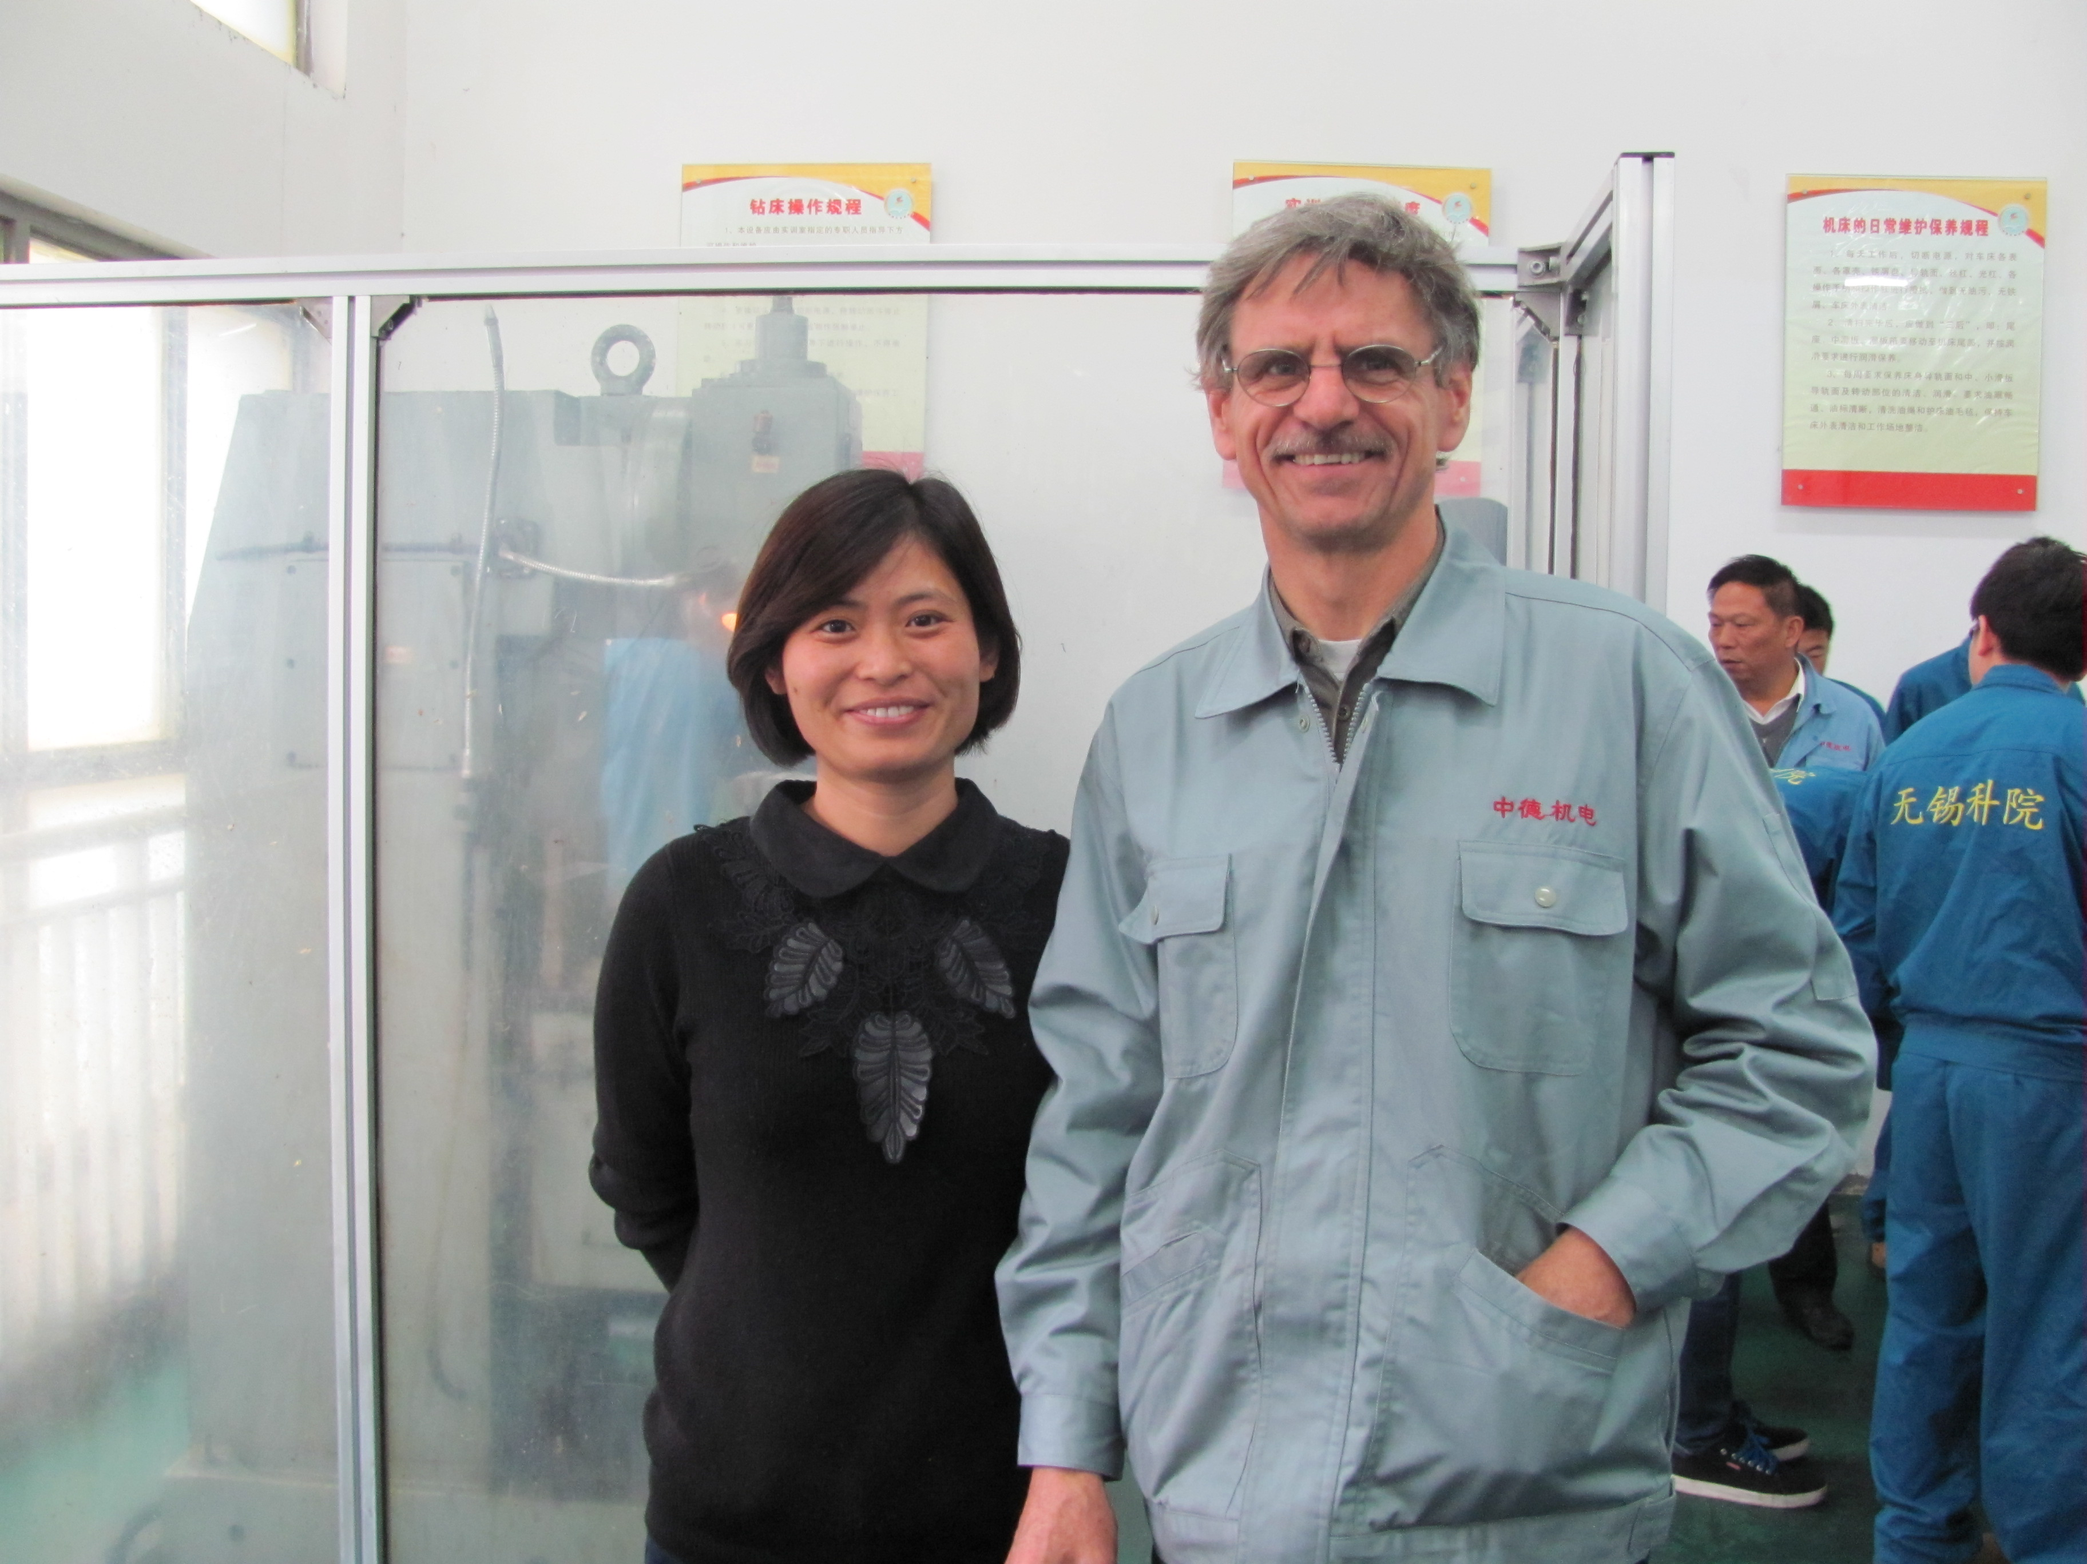
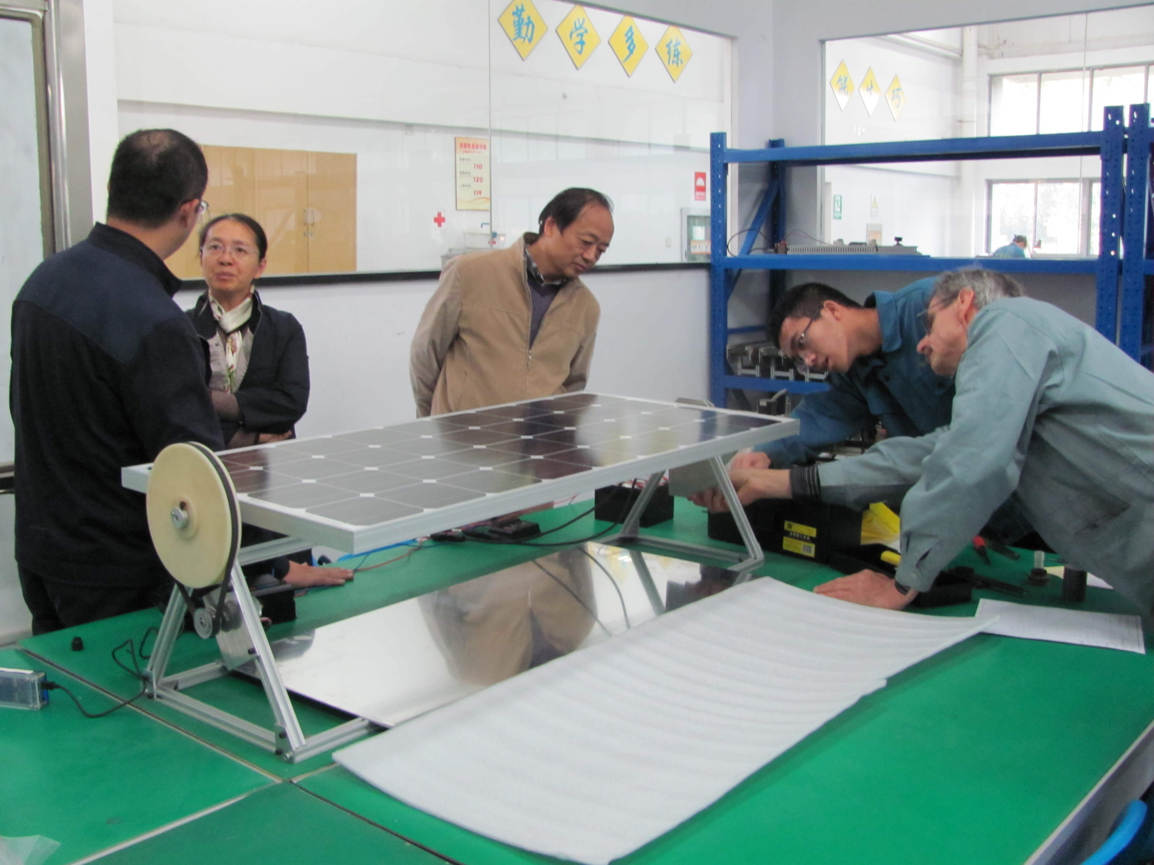

Global Teamwork

Slide 13
Cultural Observations
What is cultural bias?
What is charity?
Red tape
The cast system

Slide 14
References
1. Compare The United States To China http://www.ifitweremyhome.com/compare/US/CN
2. Compare The United States To Dominican Republic http://www.ifitweremyhome.com/compare/US/DO
3. Issue Brief: China’s Actions on Clean Power http://www.eesi.org/papers/view/issue-brief-chinas-actions-on-clean-power
4. Dominican Republic’s Energy Market http://blogs.iadb.org/caribbean-dev-trends/2013/11/27/dominican-republics-energy-market/
5. What is U.S. electricity generation by energy source? http://www.eia.gov/tools/faqs/faq.cfm?id=427&t=3

Slide 15
References
6. Caribbean Regional Electricity Generation, Interconnection, and Fuels Supply Strategy http://www.caricom.org/jsp/community_organs/energy_programme/electricity_gifs_strategy_final_report_summary.pdf
7. Where Does My Electricity Come From? http://blog.epa.gov/blog/2009/09/where-does-my-electricity-come-from/
8. Indiana - IER http://instituteforenergyresearch.org/states/indiana/
9. NRDC: Renewable Energy in Indiana http://www.nrdc.org/energy/renewables/indiana.asp

